Slide 1
Data Structures Workshop
Day 4

Slide 2
Workshop Outline
Dynamic Arrays
2D Arrays
Dynamic Array Class Practice

Slide 3

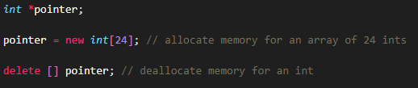
Dynamic Memory
Operator new
The operator new allocates memory (a variable) of the designated type and returns a pointer to it
Operator delete
When a dynamic variable is no longer needed, it can be destroyed; that is, its memory can be deallocated. The C++ operator delete is used to destroy dynamic variables, so that its memory space can be allocated again when needed.

Slide 4
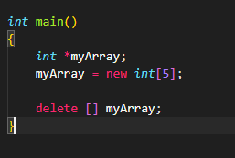
Dynamic Arrays
A disadvantage of using static arrays are their fixed size. There may be situations where we won’t know what a size of an array will be until we get a user input.
This is where dynamic arrays come in useful.

Slide 5
2D Arrays

Slide 6
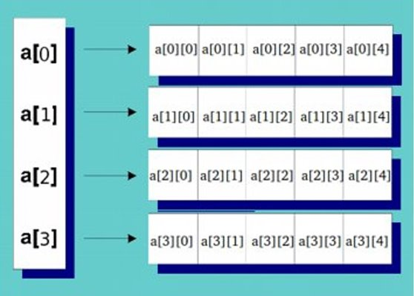
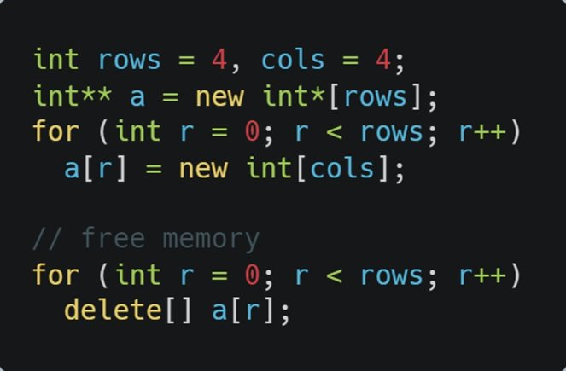
2D Arrays/Matrices
2D Arrays use double pointers - ‘a’ will hold the address of the first element of the array of integer pointers (array of pointers to arrays)

Slide 7
Practice***
Create a 2D integer array/matrix that takes in r rows and c columns, and integers from input
Traverse through the array and print it out as well (in a matrix format)

Slide 8
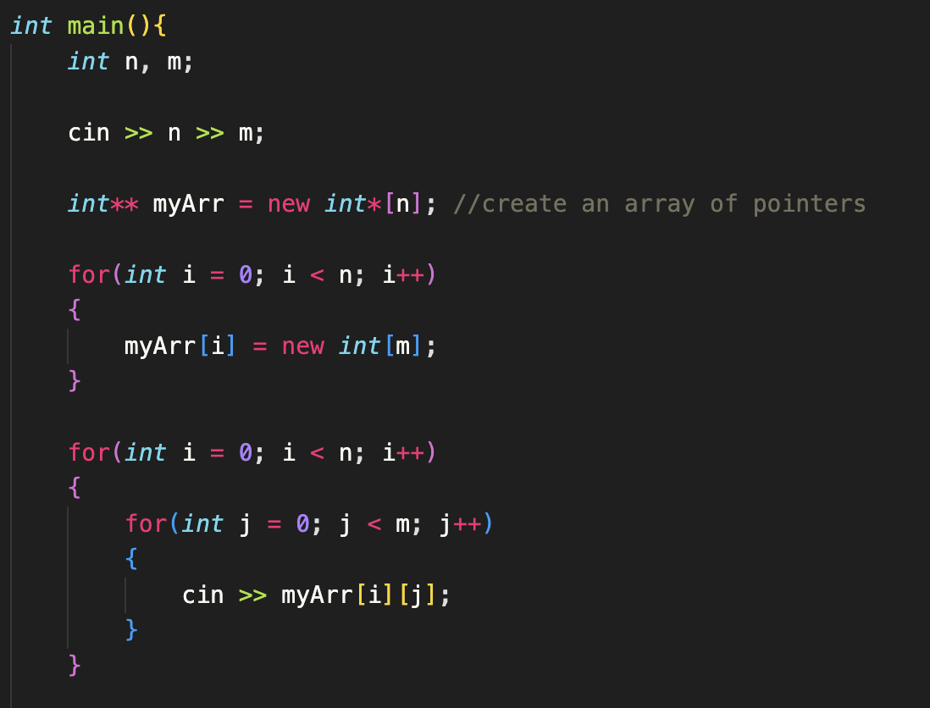
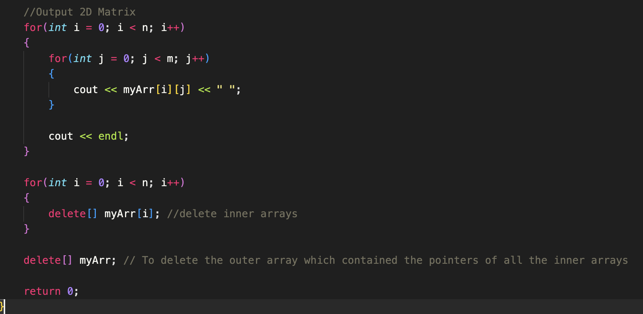
Solution

Slide 9
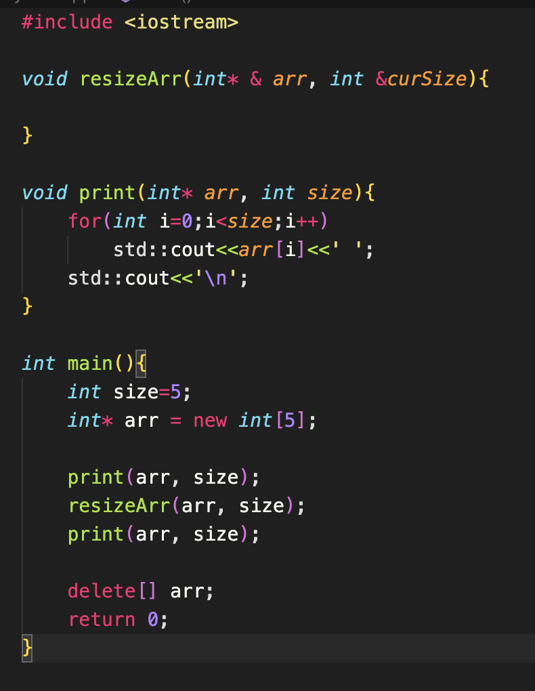
Resizing Dynamic Array
Given a dynamic array. Create a function that "resizes"
the dynamic array by doubling the size.​
Create a new array
Copy old data over to new one
Delete the old

Slide 10
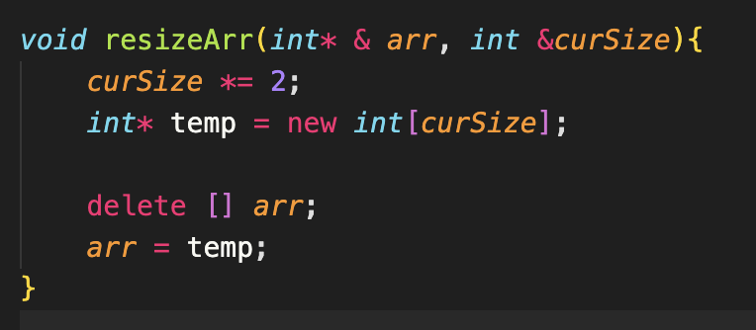
Solution

Slide 11

Dynamic Array Class
Create a class which simulates a credit account transactions. The goal of this program is to get you comfortable with allocation and deallocation of main memory.​
This exercise is divided into two files Bank.h and Bank.cpp:​
Bank.h: It contains all the member functions both their declaration​
Bank.cpp: It makes use of all the class to perform certain tasks.​
You are required to complete the following program files and ensure your program produces the correct output. Some of the functions have already been created. Complete the following:​

Slide 12
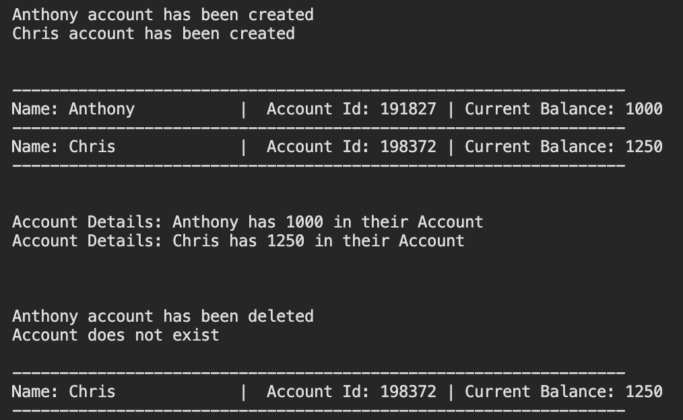
Wanted Output

